Slide 1
EMPLOYEE ATTENDANCE BY USING EXCEL
NAME : V.GOMATHI
REG NO:122204672
DEPARTMENT: 3rd B.COM (CORPORATE SECRETARYSHIP)
COLLEGE NAME:VALLAL P.T.LEE CHENGALVARAYA NAICKER ARTS & SCIENCE COLLEGE

Slide 2
AGENDA
INTRODUCTION
ATTENDANCE MANAGEMENT SYSTEM
MANNUAL SYSTEM
TYPES OF ATTENDANCE
ATTENDANCE SHEET
BENEFITS OF ATTENDANCE
IMPORTANT OF EMPLOYEE ATTENDANCE
TABLE OF SHOWING ATTENDANCE
CHART OF SHOWING ATTENDANCE

Slide 3
INTRODUCTION
Managing employee attendance holds paramount significance for organizational success.
Precise attendance management ensures that businesses can accurately track the working hours of their workforce, facilitating streamlined payroll processes and minimizing errors.
Beyond administrative efficiency, it fosters a culture of accountability, encouraging employees to adhere to schedules and deadlines.

Slide 4
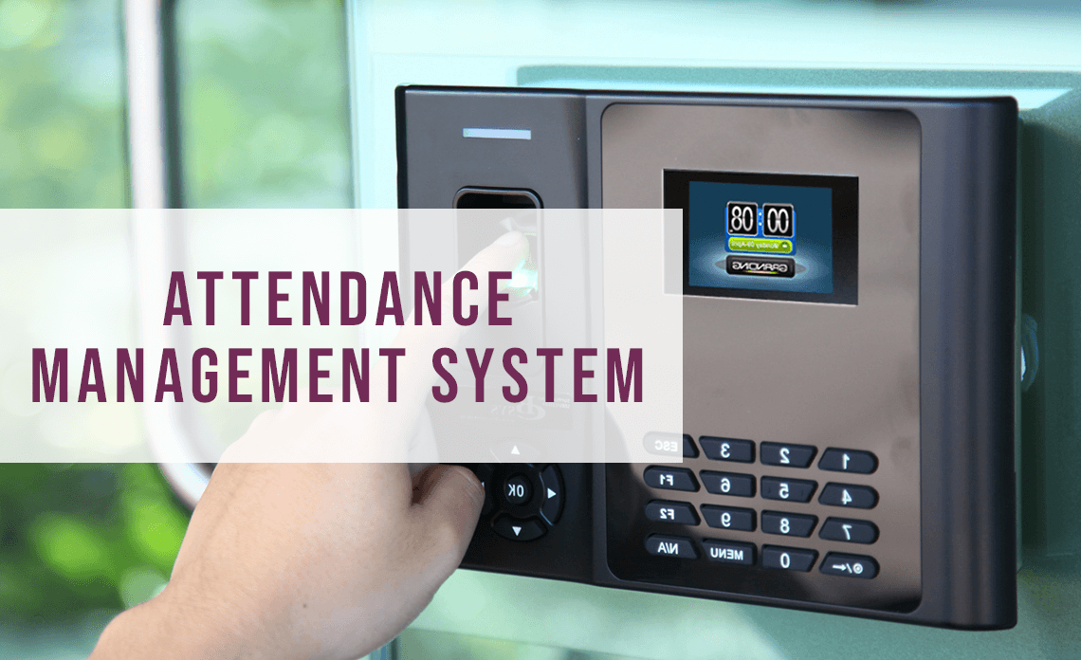
ATTENDANCE MANAGEMENT SYSTEM
An attendance management system is a mechanism used to track and manage the attendance of individuals within an organization.
In business, it records the times employees arrive and leave. It also tracks their presence during designated work periods for purposes such as compensation and time off.

Slide 5
MANNUAL SYSTEM
The manual system is a traditional approach where attendance is recorded by physical means. It typically involves sign-in and sign-out sheets, time cards, or attendance registers.
This method is simple, but it can be time-consuming and prone to errors and manipulation.

Slide 6
TYPES OF ATTENDANCE
1. Manual System – using excel or muster roll Prior to the age of technology, manual attendance was the most common method of tracking attendance. ...
2. Timesheets The sheets document when tasks are started and finished by employees. ...
3. Mechanized Systems ...
4. Time Cards/ RFID Cards ...
5. Proximity Card, Badges or Key Fobs ...
6. Biometric Attendance ...
7. Interactive Voice Response ...
8. Online Attendance Software ...

Slide 7
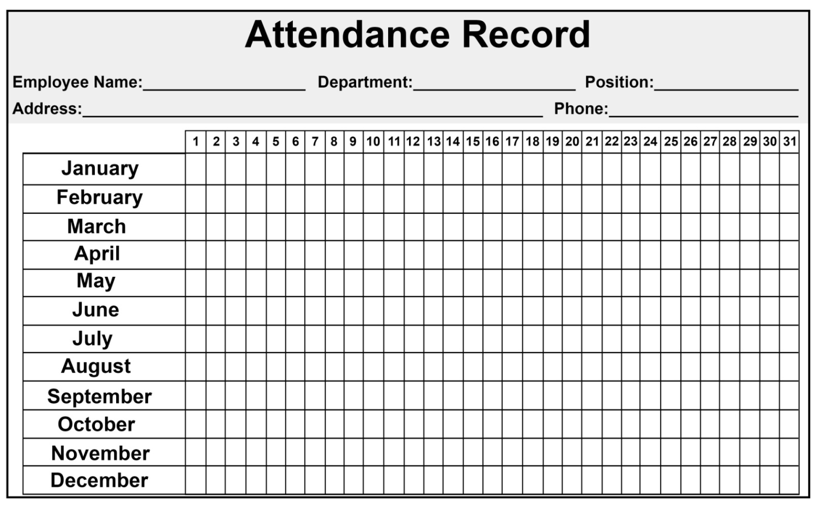
ATTENDANCE SHEET

Slide 8
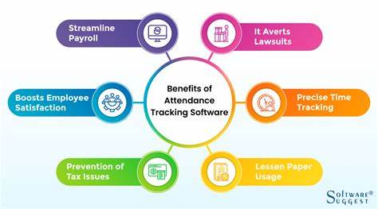
BENEFITS OF ATTENDANCE

Slide 9
IMPORTENT OF EMPLOYEE ATTENDANCE
It affects the overall productivity of the workplace
It helps build the morale of other employees and motivates them to achieve organizational objectives
It enhances the collaborative skills and team participation in daily activities.

Slide 10
ATTENDANCE
Employee NAME |  | Attendance date |  |  |  |  |  |  |  |  | Totol Attendance
 | 1 | 2 | 3 | 4 | 5 | 6 | 7 | 8 | 9 | 10
Aadi | P | P | A | A | P | P | P | P | P | P | 8
Aarav | A | P | P | P | P | P | P | P | A | P | 8
Aaranv | P | P | P | P | P | P | A | A | P | P | 8
Kevin | P | P | A | P | P | A | P | P | P | P | 8
Justin | P | P | A | P | P | P | P | P | P | P | 9
Arishnew | P | P | P | P | P | P | P | A | A | P | 8
Shivaye | P | P | P | P | P | P | P | A | P | P | 9
Aryan | P | P | P | P | P | P | A | P | P | A | 8
David | P | A | A | P | P | P | P | P | P | P | 8
Ayaan | A | P | P | P | P | P | A | P | P | P | 8
Dhruv | A | P | P | P | P | P | P | P | P | P | 9
Smith | P | P | P | P | P | P | A | P | A | P | 8
Jones | P | P | P | P | P | P | A | P | P | P | 9
Brown | P | P | P | P | P | P | P | P | P | P | 10
Davis | P | P | P | P | P | A | P | P | P | P | 9
Williams | P | P | P | P | P | A | P | P | A | P | 8
Arjun | P | A | P | P | P | P | A | P | P | P | 8

Slide 11
TOTAL ATTENDANCE

